Slide 1


Slide 2
Optimization of waste handling in surface mines

Slide 3
Introduction
The prime objective of waste dump planning is to minimize the vertical and horizontal distance between source and disposal area.
Other factors like stability, availability of dumping area, environmental hazards, types of equipments used etc. usually act counter to above objective.
Therefore, it is necessary to determine basic factors governing the waste dump plan for an opencast mine

Slide 4
objective
(1) To study factors governing waste handling in opencast mines.
(2) To optimize the waste handling capacity of an opencast mine.

Slide 5
Parameters affecting waste handling capacity of a mine

Slide 6
Economic parameters
Minimize the horizontal and vertical distance of the source to disposal area ,
Deciding type of dumping ( in-pit or ex-pit)
cost of establishing a safe dump.

Slide 7
Design parameters
(1) Economic :-
Minimize vertical and horizontal distance,
Minimize the current haulage cost versus the discounted future re-handling cost of in-pit dumps.

Slide 8
(2) Non-economic:-
Stability,
Political or surface rights,
Environmental considerations,
Physical configuration of dumps,
Method of placement,
The planned development schedule.

Slide 9
General engineering
Swell factor of the run-of-mine,
Compaction ratio,
Angle of repose of the dump material,
Supportive surface strength of dump material,
Other factors

Slide 10
Other factors
Distribution at the time of a new dump,
Notching of low levels of the dump,
Removal of vegetation and other unconsolidated material for obtaining a stable base,
End dump from pit head for good draining pattern,
Properly placing the drainage structures like culvert pipes etc.

Slide 11
Operating considerations
A slight positive gradient should be maintained at the dump to ensure that the run off will drain away from crest to natural ground.
Positive gradient is also good as the haul trucks will have to power back to dump rather than roll back.
In cases where the dump failure is serious, then an alternative dump location will have to be used until the situation is corrected.
For stabilizing dump failure we can put a layer of lower dump on the toe of the failure

Slide 12
CASE STUDY
Preparing a case study on the waste dumping management of a mine having both in-pit and ex-pit dumps.
Finding sites for in-pit and ex- pit dumping in the mine.

Slide 13
Problem statement
Previously the mine had 2 box cuts, one in A block and another one was in B block to reach the requirement of 8Mtpa. Ex-Pit dump was placed in North-West side of A block. With changes in mine sequence (i.e. start of mine from B block with 5.0mtpa capacity) we need to find place of dumping overburden.

Slide 14
Introduction
The combined area of the blocks is 7.81km2 .
The topography over the coal bearing area is gently undulating , but rises steeply to the north from the block boundary.
The coal seams are steeply dipping and the blocks are intersected by several faults.
There is total of over 20 named seams varying in thickness up to 7 m, but generally 1 to 2 meters.
Strip ratio is 5.16 bcm/t (bank cubic meters per tonnes)
A and B blocks contain 2 blocks
1) West block (A block)
2) East block (pachmo)

Slide 15
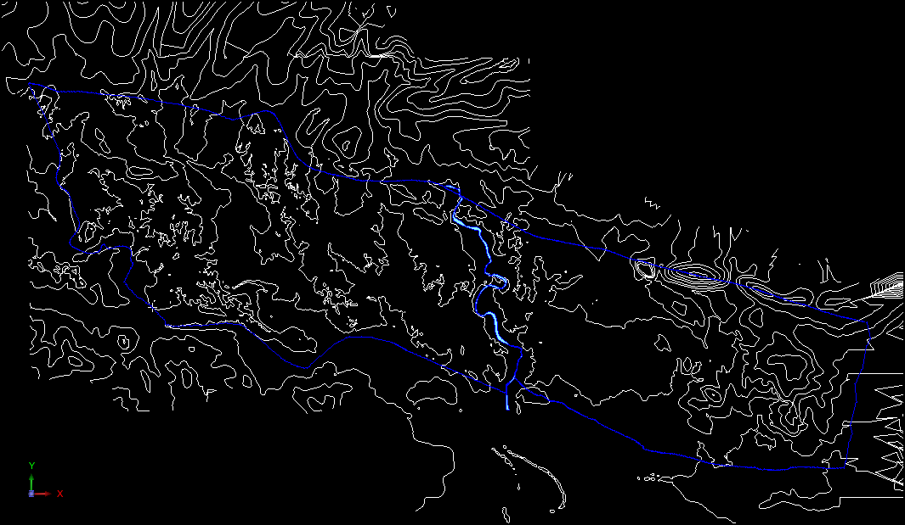
INTRODUCTION OF KBP BLOCK
B Block
Area - 865.63
A- Block
B Block
A Block
Area -1065.89
B’s Nallah

Slide 16
STUDY OF TOPOGRAPHY OF KBP BLOCK
Rl-370
Rl-360
Rl-370
Rl-350
B-Block
Rl-330
Rl-330
General Topography of Block is dipping down from West to east and North to South. RL is varying fro n 330 min to 380 maximum.
There is no perennial nala within Pachmo block bout water may ingress from Northern boundary.

Slide 17
STUDY OF COAL BEARING AREA IN AND AROUND BLOCK
Metamorphic Rock (Non Coal Bearing)
Coal Bearing area
B-Block
Coal Bearing area of other mine
Non Coal Bearing area within block

Slide 18
STUDY OF RULES AND REGULATIONS
- EC condition
- Mining Plan
- By-Laws
Conceptual dump configuration
EX-PIT DUMP
Terrace angle- 37.5 deg
30M
37.5˚
30M
Aver all dump Slopes- 28deg
30M
30M
37.5˚
90 M
30M
28˚
IN-PIT DUMP
10M
40M
30M
30M
37.5˚
28˚
30M

Slide 19
PRODCUTION SCHEDULE FOR 5.0 MTPA COAL FROM PACHMO
 | Y1 | Y2 | Y3 | Y4 | Y5 | Y6 | Y7 | Y8 | Y9 | Y10 | Y11 | Y12 | Y13 | Total
Coal -mt | 0.3 | 1.6 | 3.5 | 5.0 | 5.0 | 5.0 | 5.0 | 5.0 | 5.0 | 5.0 | 5.0 | 2.5 | 1.0 | 49.0
OB -mbCuM | 1.5 | 8.0 | 17.5 | 25.0 | 25.0 | 25.0 | 25.0 | 25.0 | 25.0 | 25.0 | 25.0 | 12.5 | 5.0 | 245.0
Terrace wise ROM Coal -MT
EBC | 0.3 | 1.0 | 2.3 | 1.9 |  |  |  |  |  |  |  |  |  | 5.5
ET1 |  | 0.6 | 0.6 | 1.6 | 2.0 | 2.0 | 2.0 | 0.8 |  |  |  |  |  | 9.5
ET2 |  |  | 0.6 | 1.6 | 2.0 | 1.6 | 1.6 | 1.6 | 0.6 |  |  |  |  | 9.6
ET3 |  |  |  |  | 1.0 | 1.4 | 1.4 | 1.4 | 2.7 | 2.7 | 2.7 | 1.1 |  | 14.2
WT6 |  |  |  |  |  |  |  | 1.3 | 1.3 | 1.3 | 1.3 | 1.5 | 0.4 | 7.0
WT5 |  |  |  |  |  |  |  |  | 0.5 | 1.0 | 1.0 |  | 0.6 | 3.1
Total | 0.3 | 1.6 | 3.5 | 5.0 | 5.0 | 5.0 | 5.0 | 5.0 | 5.0 | 5.0 | 5.0 | 2.5 | 1.0 | 49.0
Terrace wise OB-Mbcum
EBC | 1.5 | 5.0 | 11.5 | 9.5 |  |  |  |  |  |  |  |  |  | 28.0
ET1 |  | 3.0 | 3.0 | 7.8 | 10.0 | 10.0 | 10.0 | 3.8 |  |  |  |  |  | 48.0
ET2 |  |  | 3.0 | 7.8 | 10.0 | 8.1 | 8.1 | 8.1 | 2.9 |  |  |  |  | 48.0
ET3 |  |  |  |  | 5.0 | 6.9 | 6.9 | 6.9 | 13.4 | 13.4 | 13.4 | 5.3 |  | 71.0
WT6 |  |  |  |  |  |  |  | 6.3 | 6.3 | 6.6 | 6.6 | 7.3 | 2.0 | 35.0
WT5 |  |  |  |  |  |  |  |  | 2.5 | 5.0 | 5.0 |  | 2.8 | 15.0
Total OB | 1.5 | 8.0 | 17.5 | 25.0 | 25.0 | 25.0 | 25.0 | 25.0 | 25.0 | 25.0 | 25.0 | 12.5 | 4.8 | 244.0
Total OB Generation will be 245 mbcum. ( 342 Loose MCuM )
The overburden generated needs to be disposed either In-Pit or Ex-Pit
Effort should be there to minimize ex-pit dumping and maximize in-pit dumping

Slide 20
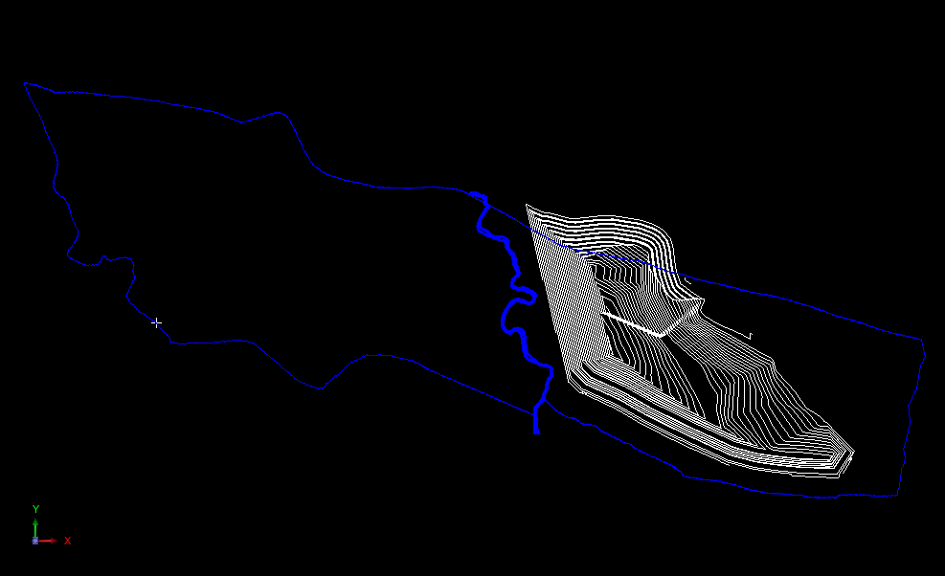
STUDY OF ULTIMATE PIT OF PACHMO
Depth of Mine 290mtra
Width- NS 1.3 KM
Width EW- 2.4 KM
Rom reserves- 48 mt
Non Coal Bearing Area=60 ha
+10m
+100m
+190m
+280m
+330m
B’s Nallah
Pit advance direction (East to West)

Slide 21
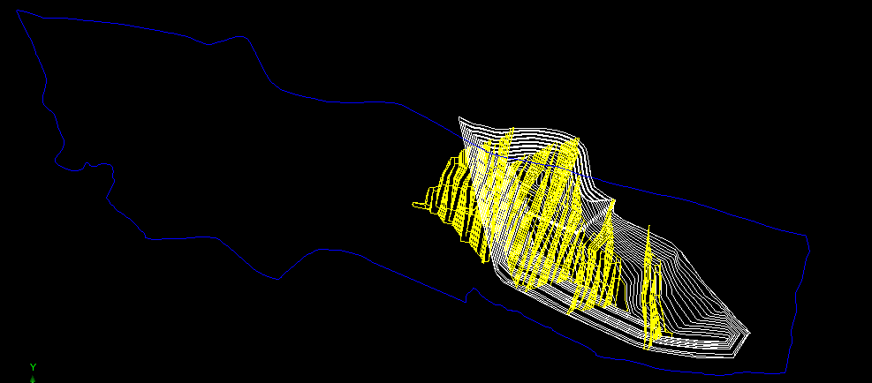
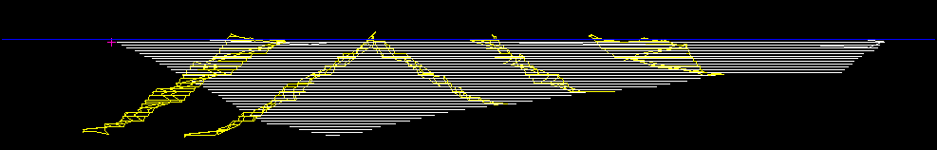
STUDY OF TERRACE SEQUENCING
ROM reserves
EBC | 5.5
ET1 | 9.5
ET2 | 9.6
ET3 | 14.2
WT6 | 7
WT5 | 3.05
Total | 48.85
A
B’s Nallah
B
Section Along - AB
WT-5
BC
WT-6
ET2
ET1
ET3
Pit advance direction (East to West)

Slide 22
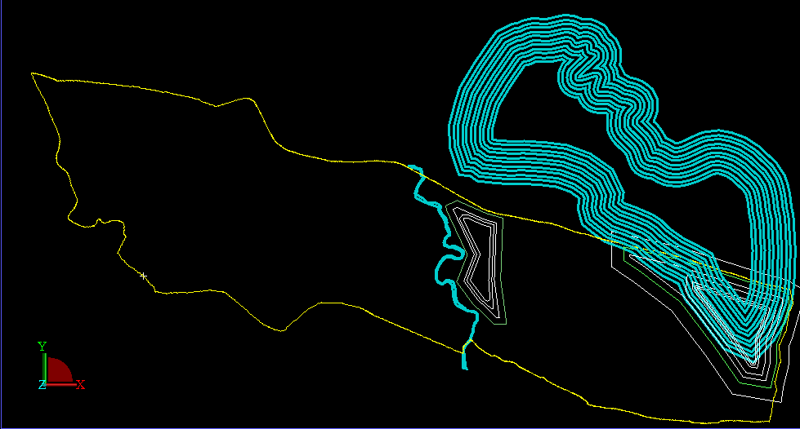
POSSIBLE LOCATIONS OF DUMPING WASTE
Dump-3
Dump-1
Dump-4
Dump-2
Dump-1: Dumping over coal bearing area located towards end of pit
Dump-2: Dumping over non-coal bearing area in North- East Part.
Dump-3: Dumping Ex-Pit along northern boundary.
Dump-4: In-Pit Dumping along with mining.

Slide 23
Criteria for In-Pit Dump Sequencing
1st In –Pit dumping can be done after the completion of Box-Cut.
Subsequent in-pit dumping is only possible after completion of each terrace.
There should be space of around 200mtrs from the toe of In pit dump and bottom of pit
Ultimate pit Geometry should be favorable for in-Pit Dumping.
T2
T1
T4
T3
BC
In-Pit Dump
45 deg
200mtrs

Slide 24
DUMP SPACE AVAILABLE
Dump-3
Dump-1
Dump-4
Dump-1: 12.4 M CuM ( to be re-handled)
Dump-2: 16.8 M CuM
Dump-3: 202 MCuM + 12.4 MCuM
Dump-4: In- Pit Dump -1: 12.5 MCuM
In-Pit Dump-2 : 35.4 MCuM
In –Pit Dump-3 : 57 .6 MCuM
Dump-2

Slide 25
OVER BURDEN DUMPING SEQUANCE
 | Y1 | Y2 | Y3 | Y4 | Y5 | Y6 | Y7 | Y8 | Y9 | Y10 | Y11 | Y12 | Y13 | Total
Total Loose OB Mbcum | 2.1 | 11.2 | 24.5 | 35.0 | 35.0 | 35.0 | 35.0 | 35.0 | 35.0 | 35.0 | 35.0 | 17.5 | 6.7 | 342.0
AVAILABLE DUMP SPACE IN MBCUM
Dump-I | 12.4
Dump-2 | 16.8 |  |  |  |  |  |  |  |  |  |  |  |  | 16.8
In-Pit BC dump |  |  |  |  | 12.5 |  |  |  |  |  |  |  |  | 12.5
In-Pit T1 dump |  |  |  |  |  |  |  |  | 35.4 |  |  |  |  | 35.4
In-Pit T1 dump |  |  |  |  |  |  |  |  |  | 57.6 |  |  |  | 57.6
Total | 29.1 |  |  |  | 12.5 |  |  |  | 35.4 | 57.6 |  |  |  | 122.2
Internal dumping-MCuM | 2.1 | 11.2 | 15.8 |  | 12.5 |  |  |  | 35.0 | 35.0 | 27.5 |  |  | 139.1
External Dumping - MCuM |  |  | 8.7 | 35.0 | 22.5 | 35.0 | 35.0 | 35.0 |  |  | 7.5 | 17.5 | 6.7 | 202.8

Slide 26
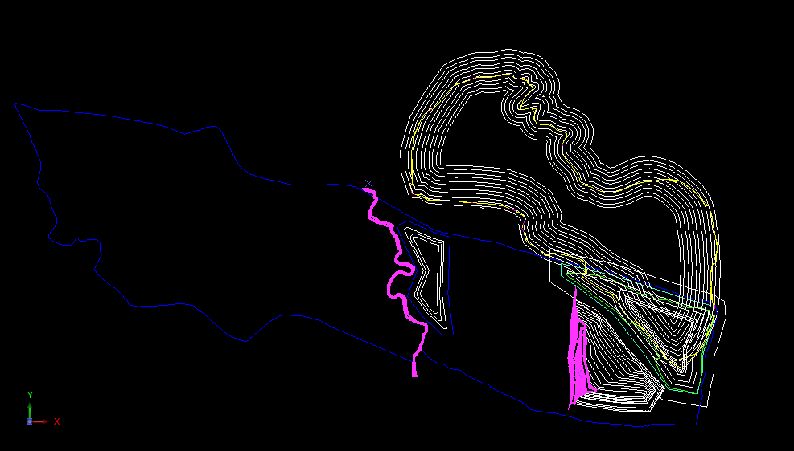
PIT POSITION AT END OF BOX CUT ( Year -4)
Ex-Pit Dump in operation
44 mCuM
Dump-1 Completed
12.4 mCuM
T-1, T2 & T3 in operation
Dump-2
Completed
16.2 mCuM
End of Box Cut

Slide 27
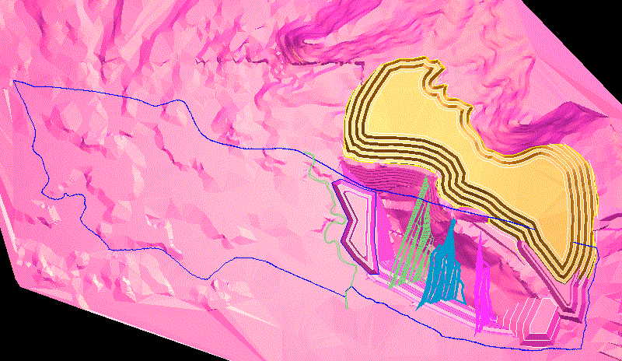
IN PIT DUMP-1 AFTER COMPLETION OF BOX CUT
( Year -5)
Ex-Pit Dump in operation
T-1, T2 & T3 in operation
In Pit Dump-1
12.5 MCum

Slide 28
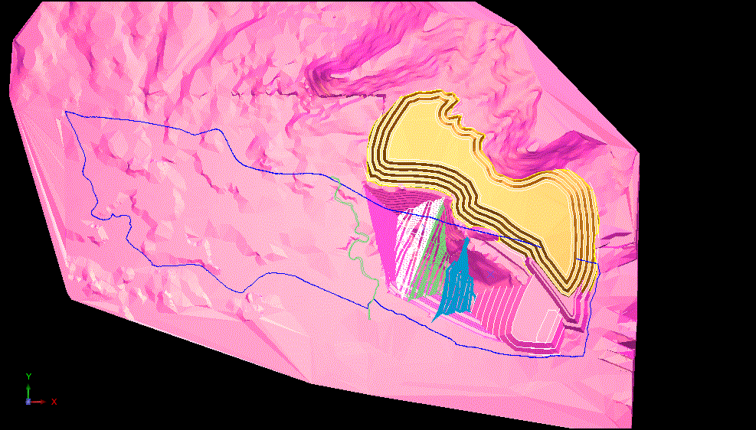
IN PIT DUMP-2 AFTER COMPLETION OF TERRACE T-1 (Year -9)
Ex-Pit Dump in operation
Dump-1 has been re-handled
T-2, T3 & WT6 in operation
In Pit Dump-2
35.4 MCum

Slide 29
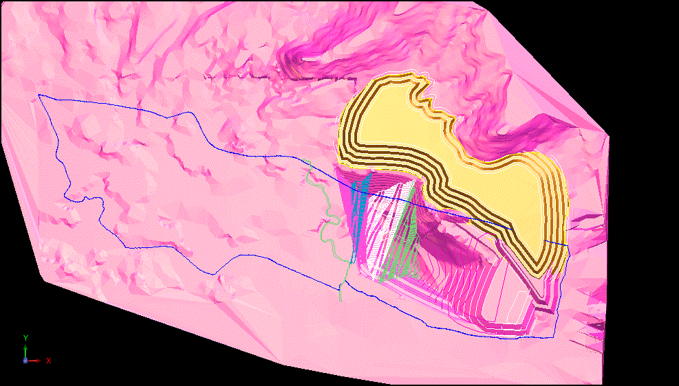
IN PIT DUMP-3 AFTER COMPLETION OF TERRACE
T-2 (Year -10)
Ex-Pit Dump in operation
T-3, WT-6 & WT5 in operation
In Pit Dump-3
57.57 MCum

Slide 30
ULTIMATE VOID AFTER -13 YEARS ( END OF LIFE OF MINE)
Ex-Pit Dump in operation
( 296 HA)
212 MCuM
T-3, WT-6 & WT5 in operation
Total Void – 173 MCuM
In Pit Dump-1 ,2 ,3
105 MCum

Slide 31
CONCLUSIONS
Ex-Pit dumping space is essential for 5.0mtpa within 2 & ½ year.
Ex-Pit dump space should be acquired within 2 &1/2 year for sustaining production level.
The area required for ex-pit dumping space is 296 hector.
Due to faster rate of production big ultimate void is formed.
However, ultimate void can be used if we continue mining in KB Block.

